Slide 1
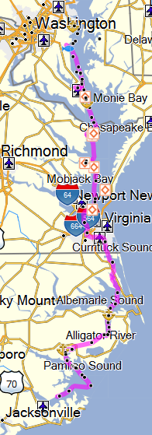
Sophia Sails Oct 2016
Herrington Harbour, Deale MD - Departed 11 Oct singlehanded, autopilot fails
Solomons Island, MD - Moored at Zahneiser’s 11-12 Oct
Reedville, VA – Anchored off Sandy Point 12-13 Oct
Deltaville, VA – Moored at Fishing Bay Marina 13-25 Oct, Elena arrives, Jamie and Jessie visit, repaired generator
Norfolk, VA – Anchored off Hospital Point 25-26 Oct
Great Bridge, VA – Moored at the City Dock 26-27 Oct
Coinjock, NC – Moored Midway Marina 27-28 Oct
Alligator River, NC – Anchored 28-29 Oct
Bellhaven, NC – Anchored 29-30 Oct
Oriental, NC – anchored 30-31 Oct, moored Oriental Marina 31 Oct

